Slide 1
Barriers to accessing new diagnostics
Dr. Mishal S Khan
Deputy Director, LSHTM TB Centre
Mishal.Khan@Lshtm@ac.uk @DrMishalK

Slide 2
Disclosure
Relations that could be relevant for the meeting | Company names
Sponsorship or refund funds | World Health Organization
Payment or other financial remuneration | None
Shareholder rights | None
Other relations | None
Reference: https://www.cgr.nl/CGR.nl/media/CGR.nl/Gedragscode/Format-of-disclosure-slide-for-speakers-at-refresher-training-meetings.pdf

Slide 3
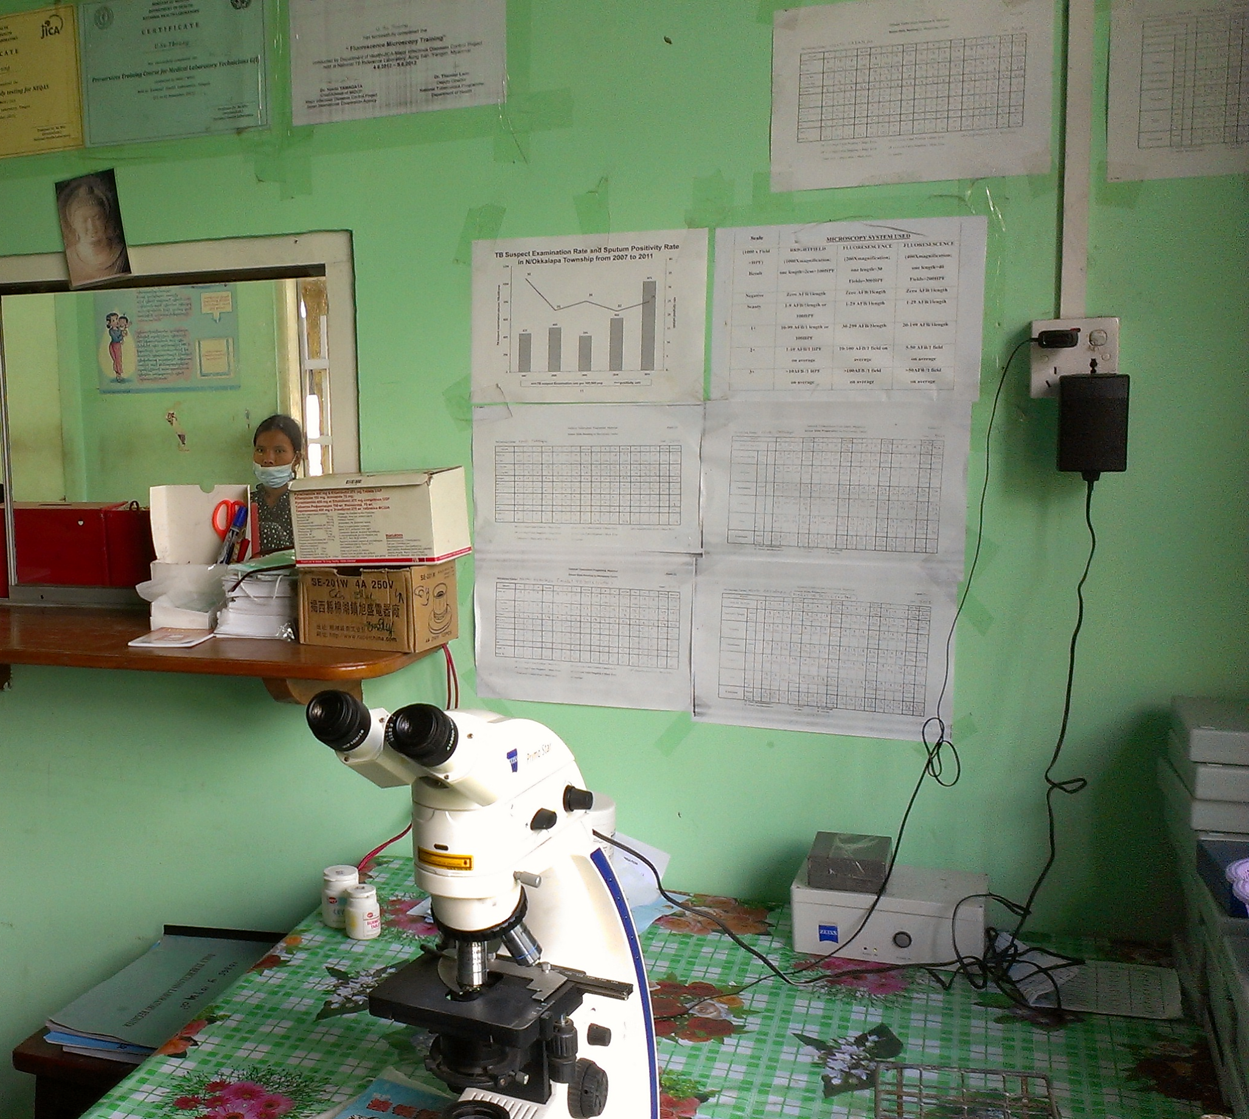
Barriers to accessing new diagnostics
“The mere availability of rapid or simple tests does not automatically ensure their adoption or scale-up.
A range of barriers prevent the successful use of point-of-care testing → economic, regulatory, and policy-related, as well as user/provider perceptions and cultural barriers”
Pai et al, 2012

Slide 4
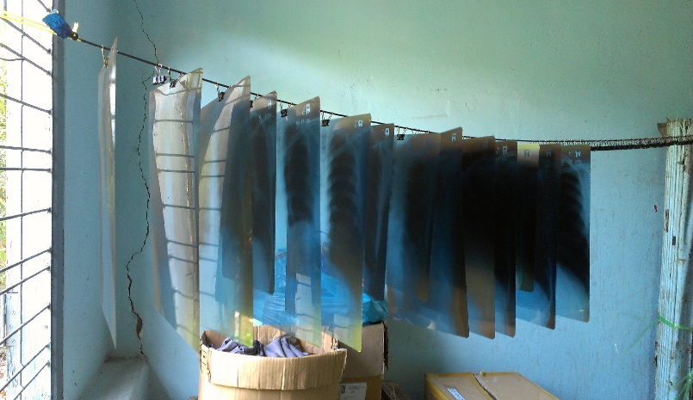
Barriers to accessing new diagnostics
Barriers to expansion of (TB/HIV) testing for early diagnosis
Hard to access quality primary healthcare services
Unregulated healthcare providers
Additional challenges related to new diagnostic tools

Slide 5
Cross-sectional analysis of delay: 76,486 Sm+ TB patients in Yunnan, China
Infected
Disease/Symptoms
Diagnosed
Start Tx
Adhere to Tx, become non-infectious
Complete Tx
Seek healthcare
Infection can be transmitted
DAYS TO REACHING DIAGNOSTIC CENTRE = 57
DAYS TO GETTING TEST RESULT = 2
DAYS TO INITIATING TREATMENT = 1
32% OF PATIENTS EXPERIENCED A DELAY OF >90 DAYS BETWEEN SYMPTOMS AND REACHING GOVERNMENT DIAGNOSTIC CENTRE – DESPITE 100% DOTS COVERAGE!

Slide 6
Drivers of delays to accessing primary healthcare services
“(Migrant workers) cannot rest, need to keep on working” - Yunnan, China
“The reason why we prefer other places is because we don’t trust providers here, they are not skilful enough.” – Cambodia
“For the services in public hospital it is very slow and delayed” - Cambodia
“It takes nine hours to get from here to the hospital in Kunming and it costs about 150 Yuan (24 USD) for a single journey. We also have to stay in a guesthouse” – Yunnan, China

Slide 7
Diagnostics and low quality healthcare providers
7 of the largest private laboratories across Karachi, Pakistan were given 6 x Mtb-spiked and 1 x Mtb negative sputum specimens using patient-actors
Laboratory ID | Laboratory Type | Correct Diagnosis
 |  | All Specimens, n (%) | Smear-Positive Specimens, n (%) | Smear-Negative Specimens, n (%)
1 | Network | 3 (42.9) | 2 (33.3) | 1 (100)
2 | Network | 7 (100) | 6 (100) | 1 (100)
3 | Standalone | 1 (14.3) | 0 (0) | 1 (100)
4 | Standalone | 1 (14.3) | 0 (0) | 1 (100)
5 | Network | 1 (14.3) | 0 (0) | 1 (100)
6 | Standalone | 6 (85.7) | 6 (100) | 0 (0)
7 | Network | 7 (100) | 6 (100) | 1 (100)
Indus Hospital | N/A | 7 (100) | 6 (100) | 1 (100)
Notes:
Codlin AJ, Javaid M, Qazi F, Khan MS. Novel methodology to assess sputum smear microscopy quality in private laboratories. BMC Infect Dis. 2012 Nov 29;12:331.

Slide 8
Barriers to accessing new diagnostics
Barriers to expansion of (TB/HIV) testing for early diagnosis
Additional challenges related to new diagnostic tools
Updating guidelines and training of healthcare professionals
Costs to patients and the healthcare system

Slide 9
Guidelines and training needed when introducing new tools
Delays with updating guidelines in high burden countries
Infrastructure and resources required to train medical professionals
Who is going to organise and pay for the training?
Is there a database of relevant medical professionals?
How frequently must continuing medical education be delivered?
Xpert MTB/RIF
Xpert Ultra
LF-LAM urine-based test

Slide 10
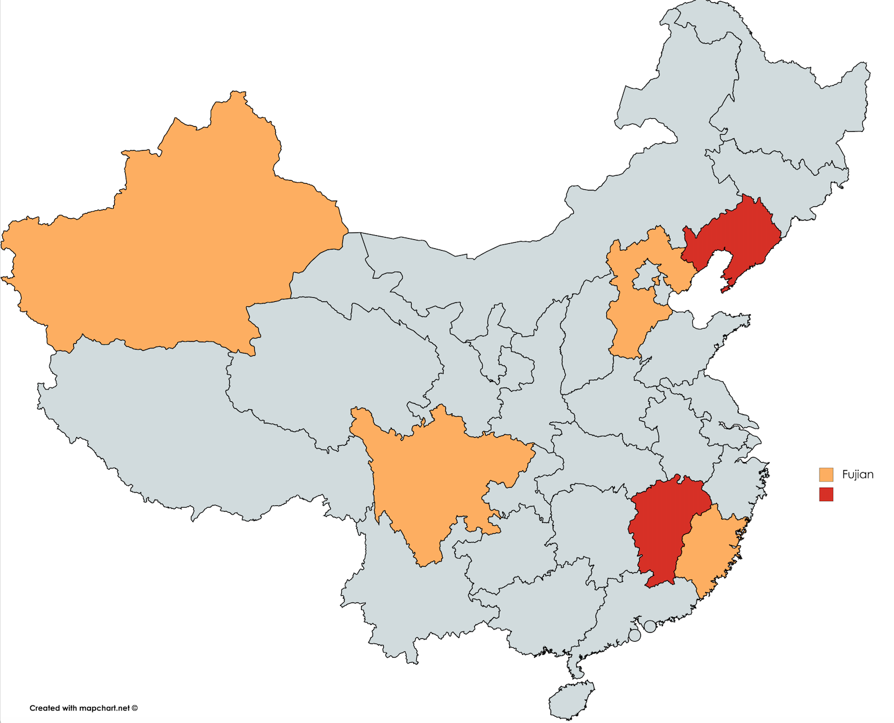
Example: MDR-TB healthcare provider training in China
China CDC/CMA provided update training on standardised diagnosis, treatment and laboratory testing of MDR-TB
6 provinces, 324 TB doctors, nurses and paramedics
Evaluation of training programme to assess knowledge retention 12 months after training
Pre- and immediate post-training tests conducted at training sessions
Phone-based knowledge survey conducted with 91 trainees from 2 provinces
Pilot provinces
Liaoning
Xinjiang
Hebei
Sichuan
Jiangxi
Fujian

Slide 11
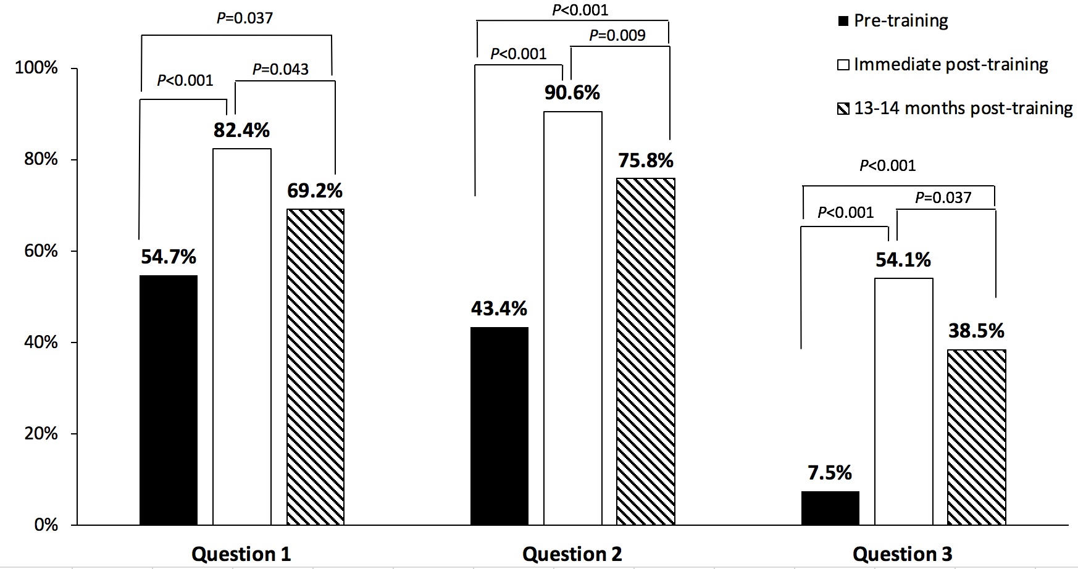
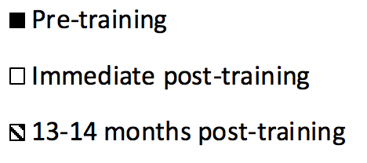
Knowledge of new tools increases and then declines after 1 year
Q1: Definitions of Drug-resistant TB
Q2: MDR-TB clinical case detection protocol
Q3: MDR-TB lab diagnosis

Slide 12
Costs matter especially when several health issues compete for resources
Costs of machines/reagents, shipping, import duties, distributor margins, lab profit margins, training staff, annual calibration
Testing volume is a major factor for cost variation[less cost-effective in peripheral settings]
Cost for diagnostic tests varies widely between settings, need country-specific cost-effectiveness analyses
Item | Unit Price (US$)
Xpert test cartridge | 9.98
Annual running cost (technician salary, training, calibration) | ~ 10,000
GeneXpert machine (depends on model) | 11,780 – 71,500
Government spending on health per capita | 3 - 20
Notes:
Higher cost of implementing XpertW MTB/RIF in Ugandan peripheral settings: implications for cost-effectiveness
http://www.stoptb.org/global/awards/tbreach/bet.asp
Xpert MTB/RIF for diagnosis of tuberculosis and drug-resistant tuberculosis: a cost and affordability analysis
https://data.worldbank.org/indicator/SH.XPD.GHED.PC.CD

Slide 13
Are we doing enough to address barriers to accessing new diagnostics?
 | 2014 Global Funding ($m)
 | Target¹ | Actual Spending² (% of target)
Drugs | 740 | 243 (33%)
Basic science | 420 | 150 (36%)
Vaccines | 380 | 111 (29%)
Diagnostics | 340 | 65 (19%)
Operational Research | 80 | 53 (66%)
Insufficient spending on RESEARCH TO INFORM IMPLEMENTATION OF NEW TOOLS!
1 = 2011–2015 Global Plan Target
2 = Treatment Action Group 2015 Report on Tuberculosis Research Funding Trends, 2005–2014: A Decade of Data
3 = From literature and consultation with LSHTM TB Centre members

Slide 14
Summary of reasons why diagnostics are difficult to access
Lack of evidence to show LMIC policymakers the value of investing in new diagnostics & usefulness of new tools in their contexts
There is not enough funding to roll out ‘best’ diagnostic tools
Healthcare providers are inadequately trained in using (new) diagnostics
Patients visit (low quality) healthcare providers that are not following guidelines
Diagnostics are located in health facilities that are too far/expensive/inconvenient to reach
Notes:
http://apps.who.int/iris/bitstream/handle/10665/44593/9789241501569_eng.pdf?sequence=1
Xpert MTB/RIF for tuberculosis testing: access and price in highly privatised health markets
Higher cost of implementing XpertW MTB/RIF in Ugandan peripheral settings: implications for cost-effectiveness
For example, there are very few cost-effectiveness studies for LF-LAM test in current literature (I only found 1 cost-effectiveness study for LF-LAM in Uganda)

